Slide 1

Amazon Sales Data

Slide 2
Introduction
Sales management has gained importance to meet increasing competition and the need for improved methods of distribution to reduce cost and to increase profits. Sales management today is the most important function in a commercial and business enterprise. Do ETL: Extract-Transform-Load some Amazon dataset and find for me Sales-trend -> month-wise, year-wise, yearly_month-wise Find key metrics and factors and show the meaningful relationships between attributes. Do your own research and come up with your findings.

Slide 3
Details of Data
The given dataset consists of 101 rows and 14 columns while using tableau it consists of 8 variables which belongs to dimension (Categorical Variables) and 6 Variables belongs to measures (Continuous Variables) also created various calculated field like Average Profit, Average Cost, Average Revenue ,Count of No of Items, and Parameters as well as used active filters in the dashboard etc.

Slide 4
Main KPI
Total Profit-Total Profit of all item/s in the company
Total Revenue-Total Revenue of all item/s in the Company
Total Cost-Total Cost of all item/s in the Company
Average Profit – Average Profit of the item/s in the Company
Average Revenue- Average Revenue of the item/s in the Company
Average Cost-Average Cost of the item/s in the Company
No of Items-Count of Items

Slide 5
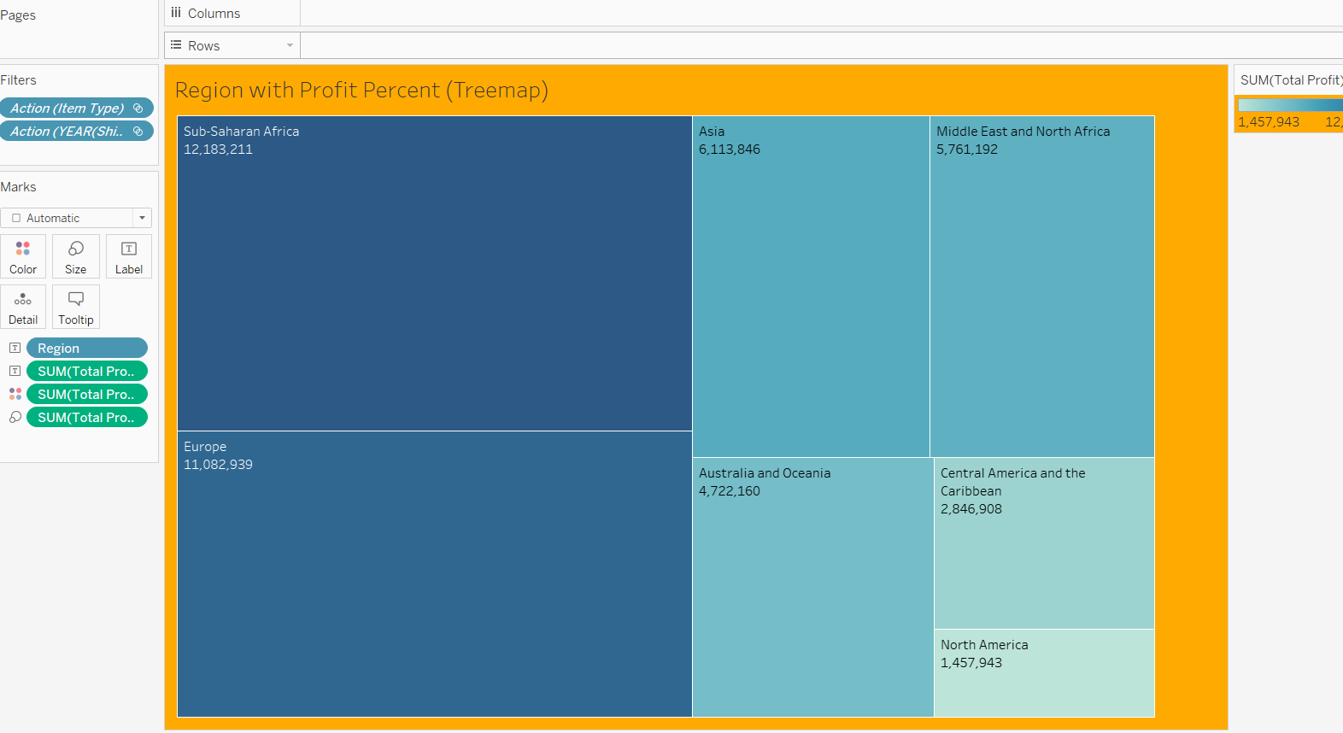
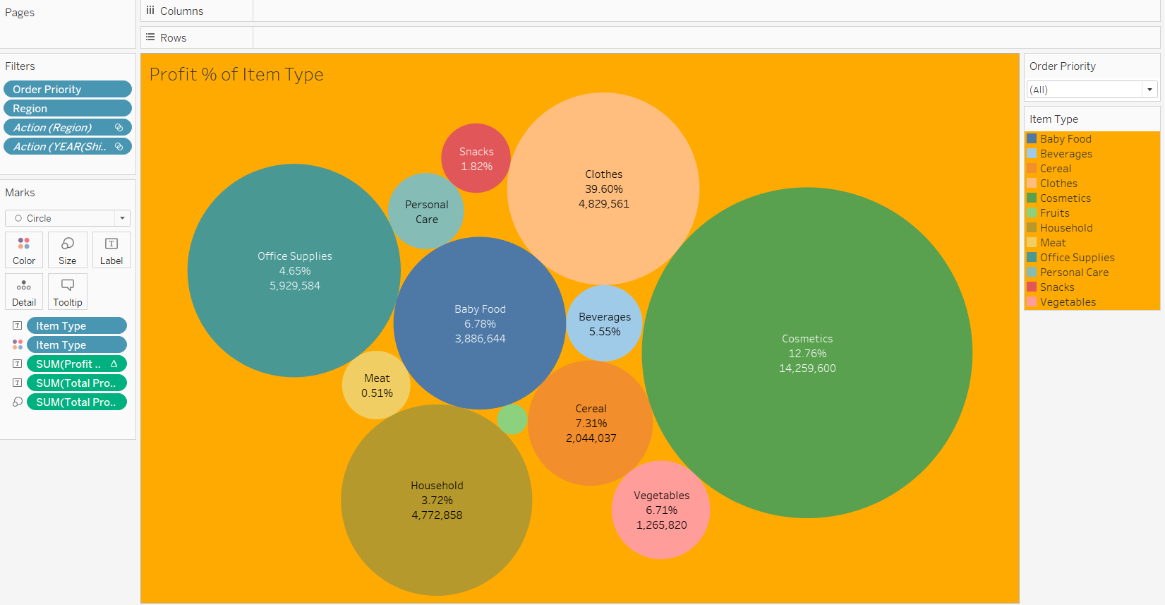
Graphs
Treemap
Packed Bubbles

Slide 6
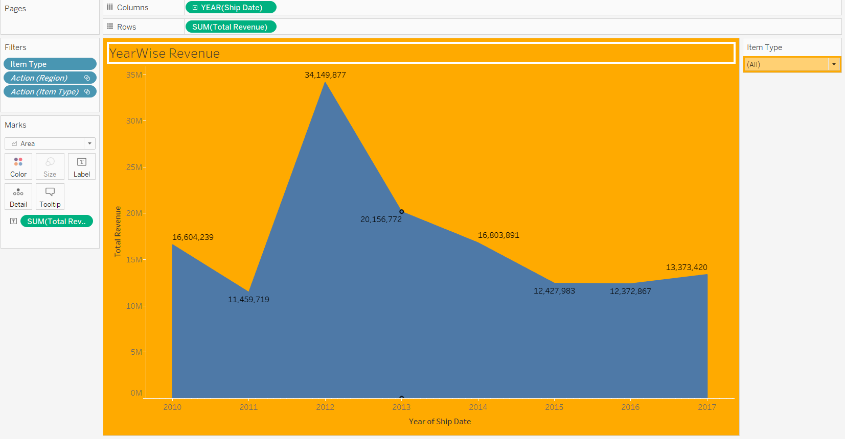
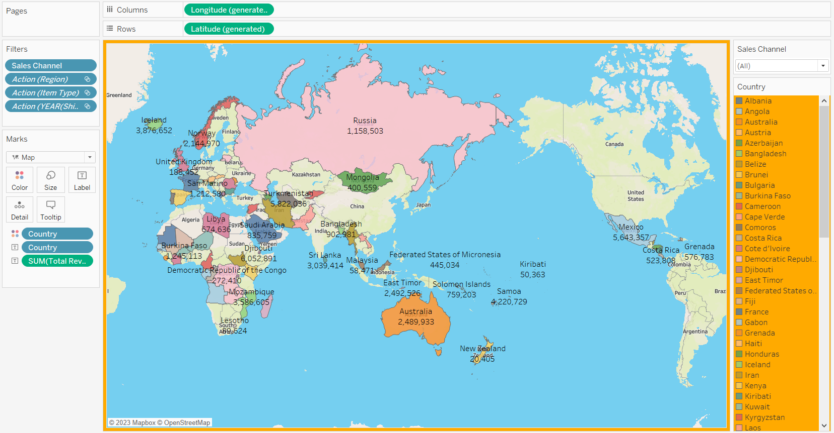
Graphs & Maps Creation
Area Chart
Creating Maps

Slide 7
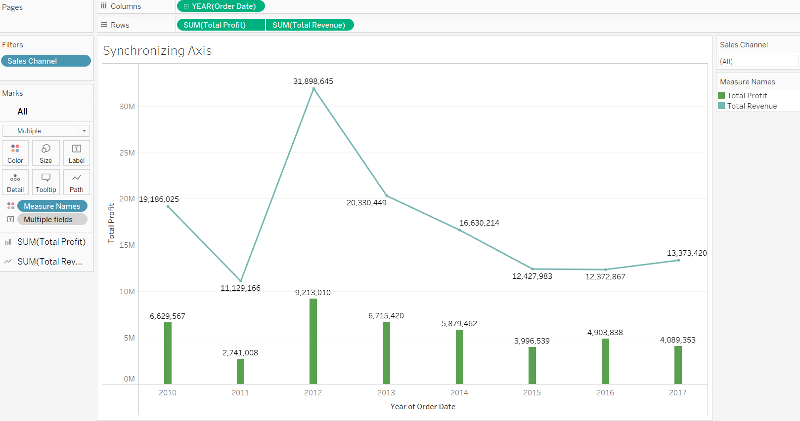
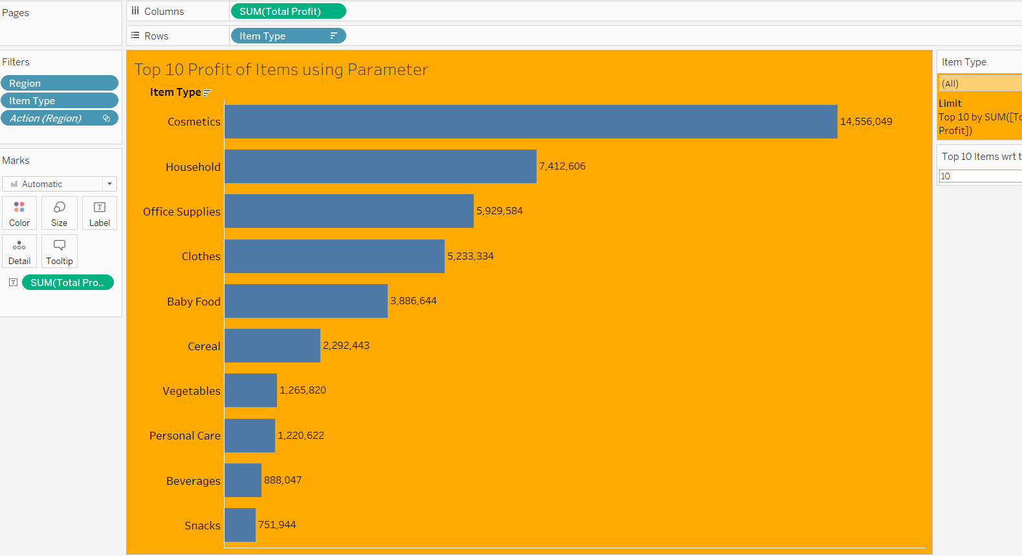
Synchronizing Axis and Parameter Creation

Slide 8
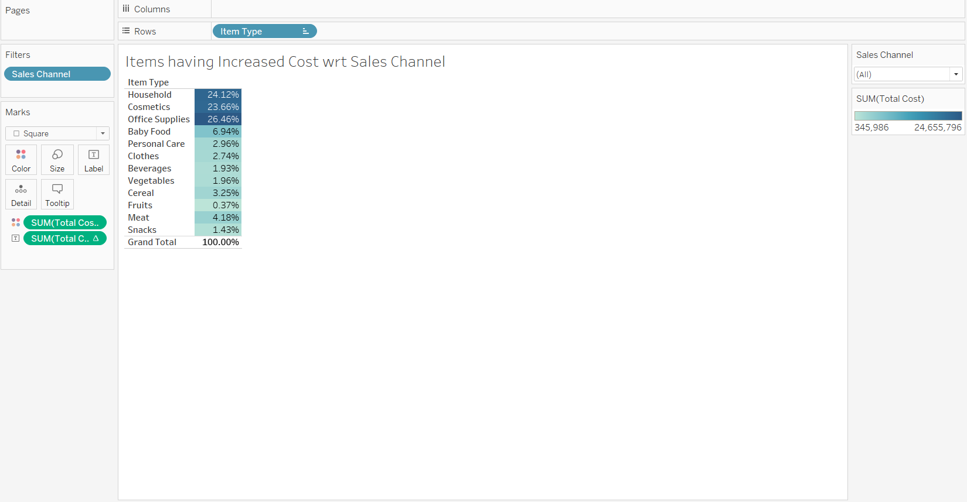
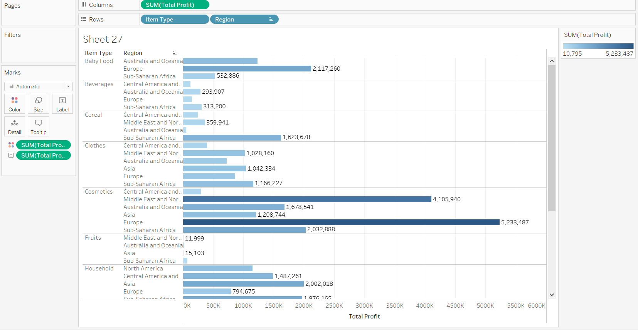
Items having increased Cost with respect to Sales Channel and it’s maximum profit in the region

Slide 9
Conclusion
North America has the maximum sales of product in offline (i.e. 100%)
The top 3 regions in percent wise which consist of maximum sales channel in online are as follows Middle East and North Africa,Asia,Europe etc
The top 5 countries which consists of maximum revenue is as follows 1)Turkmenistan,2)Mexico,3)Lithuania,4)Iceland,5)Mozambique,6)Spain etc.
The products which consists of maximum cost are Cosmetics, Office Supplies, Household etc.
The products which are having maximum profits are Clothes,Cosmetics,Cereal,Baby Food,Vegetables,Beverages etc.
And out of the12 products only 6 products are those which consists of minimum cost and maximizing Profit
Cosmetics is the only product which consists of maximum cost and profit so the company has to decide a strategy to reduce the cost and maintaining the maximum profit

Slide 10
Amazon Sales Analysis Dashboard Link
My Amazon Sales Dashboard Link is as follows
https://public.tableau.com/app/profile/karthik.murthy/viz/AmazonSalesDashboard_16946242796750/AmazonSalesDashboard

Slide 11
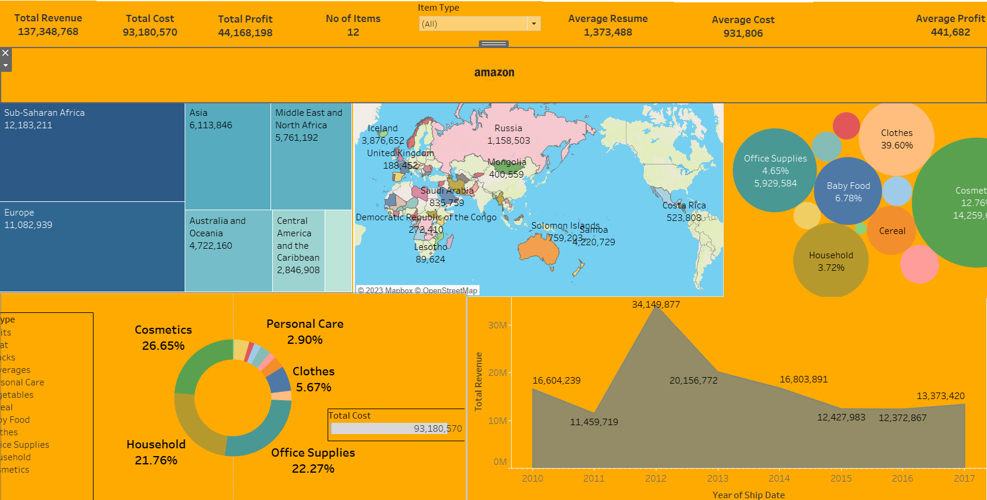
Dashboard of the Project

